Slide 1

Electromagnetic Field Coupling
Farhad Rachidi
Swiss Federal Institute of Technology (EPFL)
EMC Laboratory
Farhad.Rachidi@epfl.ch
http://emc.epfl.ch

Slide 2
Outline
Transmission line theory
Two-conductor transmission line in presence of an external electromagnetic field
Generalized Telegrapher’s Equations
Equivalent Models

Slide 3
Outline
Transmission line theory
Two-conductor transmission line in presence of an external electromagnetic field
Generalized Telegrapher’s Equations
Equivalent Models

Slide 4
Introduction
Note that this is equivalent to a two parallel conductor line
Several approaches are possible
Quasi-static
Antenna Theory
Transmission Line Theory

Slide 5
Quasi-static
Lumped elements
Propagation effects not considered
Applicable only to electrically short lines, with dimensions much smaller than the smallest wavelength involved

Slide 6
Antenna Theory
Based on the resolution of Maxwell’s Equations
Good accuracy
It requires large computer ressources for lines that are several wavelengths long

Slide 7
Transmission Line Theory
Represents an excellent compromise between computer resources and accuracy
A number of assumptions are involved…

Slide 8
Transmission Line Theory Assumptions
E
Propagation direction
H
Reference conductor
Propagation takes place along the axis of the line
The sum of the currents at any cross section is zero
The response of the line is quasi-TEM: The electromagnetic fields produced by the response of the line are confined to the transverse plane

Slide 9
Limitations of the Transmission Line Theory
For very high frequencies, the transverse dimensions of the line are not much smaller than the wavelength…
Other modes may be supported by the structure
For many systems, no analytical expression is available for the cutoff frequencies of higher-order modes
A good rule of thumb is that the cross-sectional dimensions should be less than one-tenth the minimum wavelength
< λ/10

Slide 10
On the assumption that the sum of the line currents at any cross section is zero
The assumption that the sum of the line currents at any cross section of the line is zero implies that we are considering only ‘transmission line mode’ currents and neglecting the so-called ‘antenna-mode’ currents. If we desire to compute the load responses of the line, this assumption is adequate, because the antenna mode current response is small near the ends of the line. Along the line, however, the presence of antenna-mode currents makes that the sum of the currents at a cross section is not necessarily equal to zero.
However, the quasi-symmetry due to the presence of the ground plane results in a very small contribution of antenna mode currents and consequently, the predominant mode on the line will be transmission line.)

Slide 11
On the assumption that the sum of the line currents at any cross section is zero
I_{a}(x)
E^{inc}
Z_{L}
Antenna current
I_{a}(x)
Z_{L}
H^{inc}
.
^
k
Incident field
I₁(x)
Z_{L}
Z_{L}
=
Total current
I₂(x)
I_{t1}(x)
Z_{L}
TL current
I_{t2}(x)
Z_{L}
Decomposition of line current and charge into antenna and transmission line (TL) components

Slide 12
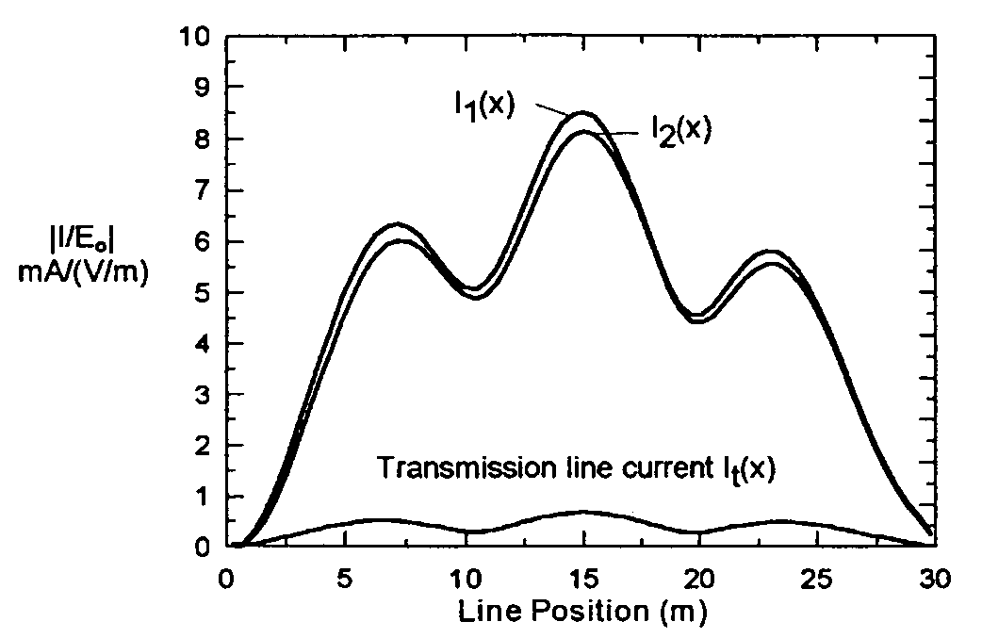
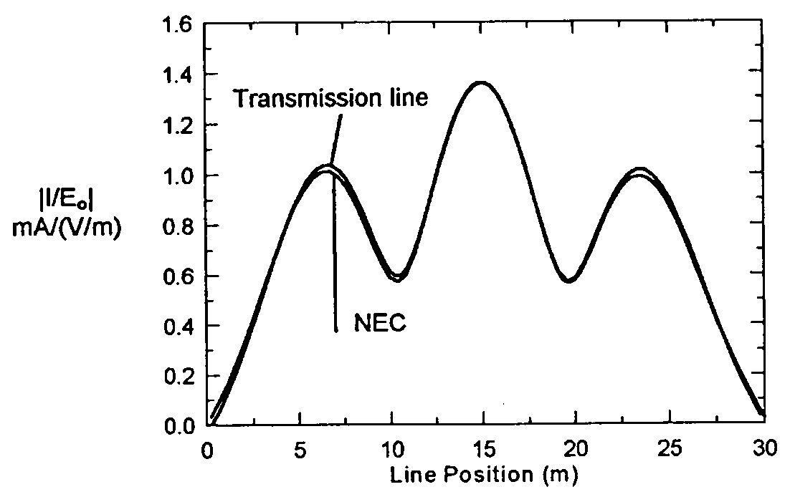
On the assumption that the sum of the line currents at any cross section is zero
Incident plane wave, angle of incidence 60º, f = 20 MHz (λ=15 m), Z_{o}=Z_{L}=293 Ω, distance between
two wires d=20 cm, L=30 m.
Magnitudes of the total wire currents I₁ and I₂ and the transmission line component I_{t1} as a function of position along the line of previous slide
(30 m long).
Magnitudes of the current distribution along a 30 m long line over a perfect ground using the transmission line (TL) theory and the antenna theory

Slide 13
Outline
Transmission line theory
Two-conductor transmission line in presence of an external electromagnetic field
Generalized Telegrapher’s Equations
Equivalent Models

Slide 14
Generalized Transmission Line Equations
Let us consider a single-conductor line above a ground plane (equivalent to a two-conductor line in free space):
Cross section:
r
z
h
y

Slide 15
Generalized Transmission Line Equations
TOTAL FIELD
Excitation (incident) field
Scattered field
Notes:
A derivation made almost half a century ago follows.
It is, as for many EM problems, mostly mathematical manipulations once you set up the problem.
The physical “insights” that are needed are the following:
The excitation field is the field that would be present if the structure were not there.
The excitation field is arbitrary but it should: a) satisfy Maxwell’s equations by itself and b) it can have field components in any direction. This separates it from the scattered fields, which are assumed to be TEM or at least quasi TEM.
We will bend the rules as we will be defining a “voltage” using a non conservative field, for which the curl is not zero.

Slide 16
Generalized Transmission Line Equations
What comes is a derivation made almost half a century ago.
The physical “insights” that are needed are the following:
The excitation field is the field in absence of the line
The excitation field should satisfy Maxwell’s equations
It can have field components in any direction (the scattered field cannot under our quasi TEM assumption)
We will allow ourselves to define a voltage that depends on the path of integration (the curl of E is not zero).

Slide 17
Derivation of the First Telegrapher’s Equation
Faraday’s Equation:
x + Δx
Dividing by Δx and taking the limit when Δx tends to 0, we obtain

Slide 18
Derivation of the First Telegrapher’s Equation
Perfect wires:
Transverse Voltage:

Slide 19
Derivation of the First Telegrapher’s Equation
Lossless Two-Conductor Line
Derivation of the 1st Generalized TL Equations
We will use this again later

Slide 20
Derivation of the Second Telegrapher’s Equation
Let us now integrate from 0 to h and separate B into the excitation and scattered components:

Slide 21
Derivation of the Second Telegrapher’s Equation
Maxwell’s equations apply also to the exciting field components:
Quasi-TEM response of the line:
and

Slide 22
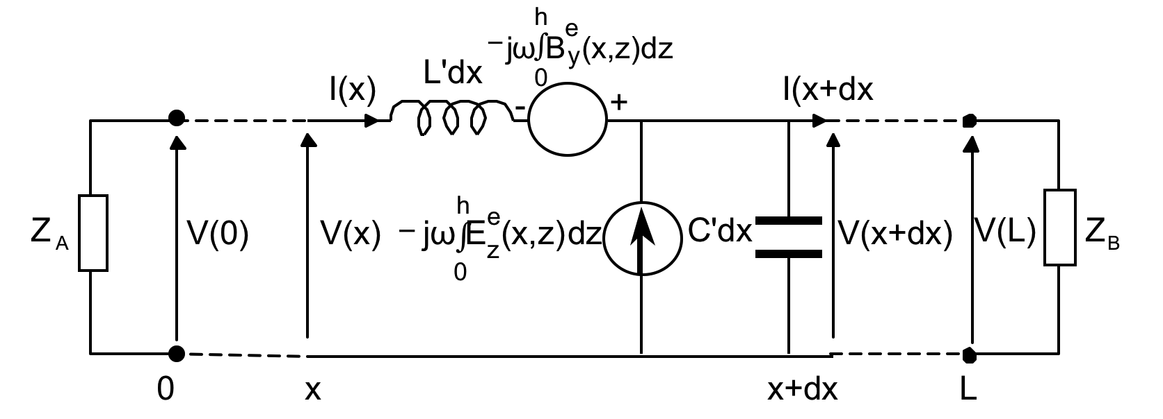
Generalized Transmission Line Equations
(Taylor, Satterwhite and Harrison, 1965)
Lossless Two-Conductor Line
Derivation of the 2nd Generalized TL Equations
In summary, neglecting the transverse conductance G’
This model is referred to as the Taylor et al. model.
Boundary Conditions
Equivalent Circuit:

Slide 23

Generalized Transmission Line Equations
(Taylor, Satterwhite and Harrison, 1965)
Lossless Two-Conductor Line
Derivation of the 2nd Generalized TL Equations
In summary, neglecting the transverse conductance G’
This model is referred to as the Taylor et al. model.
Boundary Conditions
Equivalent Circuit:
C.D. Taylor

Slide 24
Generalized Transmission Line Equations
(Taylor, Satterwhite and Harrison, 1965)
Lossless Two-Conductor Line
Derivation of the 2nd Generalized TL Equations
In summary, neglecting the transverse conductance G’
This model is referred to as the Taylor et al. model.
Boundary Conditions
Equivalent Circuit:

Slide 25
Classical Transmission Line Equations
(Telegrapher’s Equations)
Lossless Two-Conductor Line
Summary of Generalized Equations
No external sources
Classical Telegrapher’s
equations

Slide 26
Transmission Line Parameters: Two-Conductor Line
Lossy Two-Conductor Line
Line per-unit-length Parameters
Calculation of the per unit length parameters
r₁
z
h
r₂
y
For two conductors in a homogeneous medium, we have

Slide 27
Transmission Line Parameters: Single Wire above a Ground Plane
Lossy Two-Conductor Line
Line per-unit-length Parameters
r
z
h
y

Slide 28
Outline
Transmission line theory
Two-conductor transmission line in presence of an external electromagnetic field
Generalized Telegrapher’s Equations
Equivalent Models
Multiconductor Lines

Slide 29
Transmission Line Coupling Equations in Terms of Electric Fields
Agrawal. Price and Gurbaxani published a set of coupling equations in 1980.
They are based on the so-called scattered voltages and currents
z
h
Z_{A}
y
Z_{B}
x
0
L
x
x+dx

Slide 30
Transmission Line Coupling Equations in Terms of Electric Fields
To obtain to total voltage in the model of Agrawal et al., one needs to add the calculated scattered voltage to the incident voltage:
The boundary conditions are

Slide 31
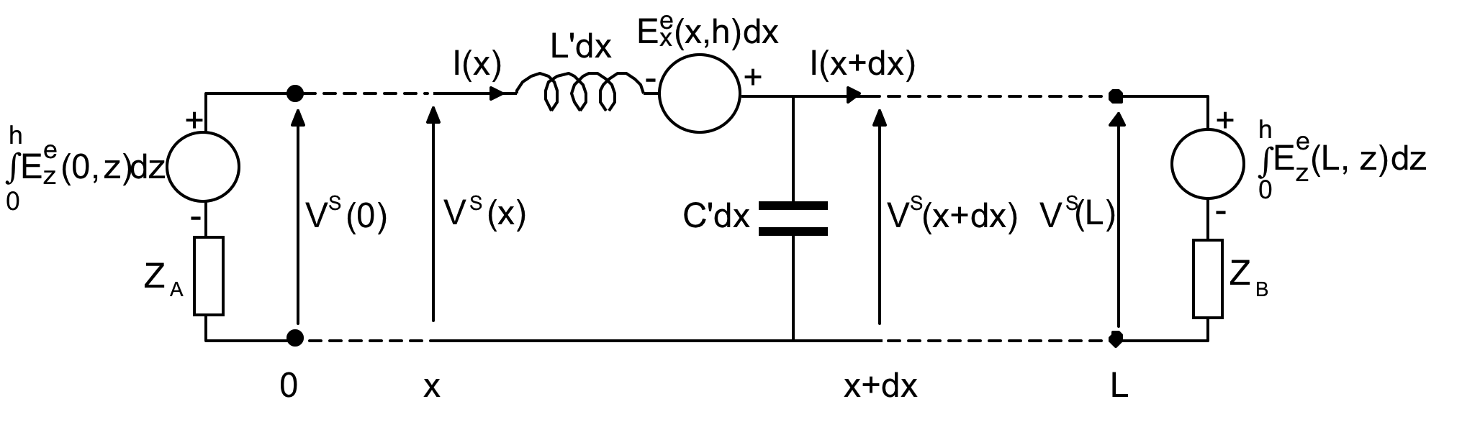
Transmission Line Coupling Equations in Terms of Electric Fields
The equivalent circuit for the Agrawal et al. model can be drawn as follows:
Note that there is one source and this is expressed as an electric field only

Slide 32

Transmission Line Coupling Equations in Terms of Electric Fields
The equivalent circuit for the Agrawal et al. model can be drawn as follows:
This model is referred to as the Agrawal et al. model.
Ashok Agrawal
Note that there is one source and this is expressed as an electric field only

Slide 33
Transmission Line Coupling Equations in Terms of Magnetic Fields
A set of coupling equations can be derived in which only the excitation magnetic field appears as a forcing function (Rachidi, 1993)
The scattered current is related to the total current as
And the excitation current is defined as

Slide 34
Transmission Line Coupling Equations in Terms of Magnetic Fields
The boundary conditions in this model are given by
Only one
current source
And the equivalent circuit model is

Slide 35
The three models

Slide 36
The three models
The three models are mathematically equivalent and they will provide the same response in terms of total voltage and total current.

Slide 37
Contribution of Field Components
Contribution of field components
Example: Induced voltages by lightning on a 1 km long, 10 m high overhead wire matched at its two extremities
Top View

Slide 38
E & B
80
60
40
Induced Voltage (kV)
20
0
-20
-40
-60
0
1
2
3
4
5
6
7
8
Time (microsec)

Slide 39
Contribution of field components
E & B
E field only
Induced Voltage (kV)
Induced Voltage (kV)
RACHIDI
H field only
Induced Voltage (kV)

Slide 40
Contribution of field components
E & B
E field only
Induced Voltage (kV)
Induced Voltage (kV)
The contribution of a given EM component depends on the adopted model!
H field only
Induced Voltage (kV)

Slide 41
Homework
Homework for next week:
1. Derive the equations of the Agrawal model starting from the Taylor model.
2. Briefly discuss the advantages/disadvantages of the three models from a numerical point of view.
You can submit your homework either electronically or bring it on paper.

Slide 42
Outline
Transmission line theory
Two-conductor transmission line in presence of an external electromagnetic field
Generalized Telegrapher’s Equations
Equivalent Models
Multiconductor Lines

Slide 43
Extension to multi-conductor lines
If the line consists of more than one conductor

Slide 44
Extension to multi-conductor lines
The equations of Agrawal et al. can be written for a multi-conductor line in terms of the scattered voltage and the current as follows
These terms account for the finite ground conductivity and the non zero conductivity of the air or dielectric between conductors

Slide 45
Extension to multi-conductor lines
The boundary conditions for the multi-conductor line can be written as follows

Slide 46
References and Further Reading
[1] F.M. Tesche, M. Ianoz, T. Karlsson, Emc Analysis Methods and Computational Models, Wiley, 1997.
[2] C.R. Paul, Transmission Lines in Digital and Analog Electronic Systems, Wiley, 2010.
[3] F. Rachidi, A Review of Field-to-Transmission Line Coupling Models with Special Emphasis to Lightning-Induced Voltages, IEEE Transactions on Electromagnetic Compatibility, Vol. 54, No. 4, pp. 898 - 911, 2012.

